Slide 1
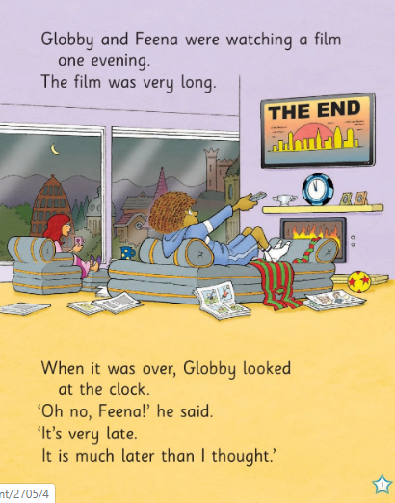
Who is sitting in the sitting room?
Is the room tidy?
Name 5 things you can see in the room
How many papers are in the room?
What does Feena have in her hand?

Slide 2
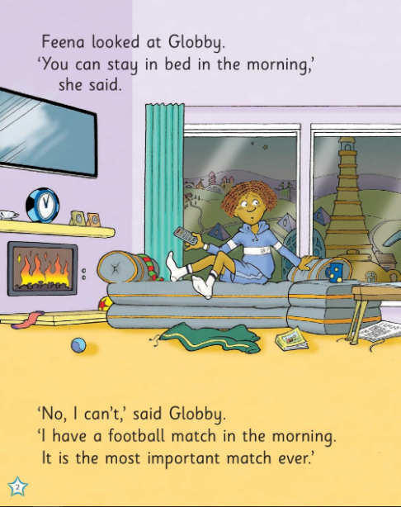
How many things are on the floor?
What time is on the clock?
What could be in the blue cup?
How does Globby look?

Slide 3
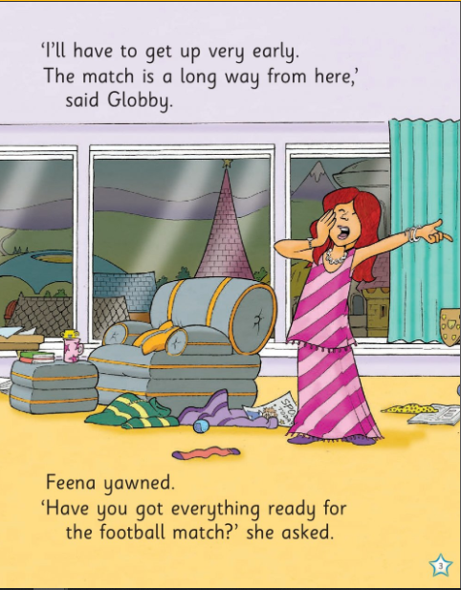
What is Feena doing?
Count the things on the floor
How do we know the cup is Feena’s?
What colour is the couch?

Slide 4
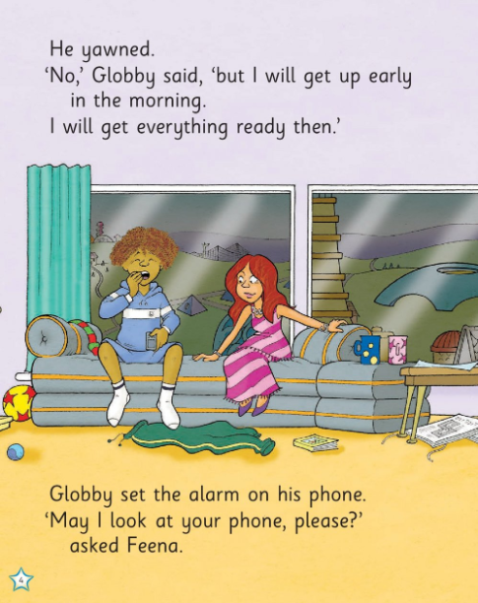
Why are they not cleaning up before they go to bed do you think?
Name the clothes that Globby has on.
What colour are the curtains?

Slide 5
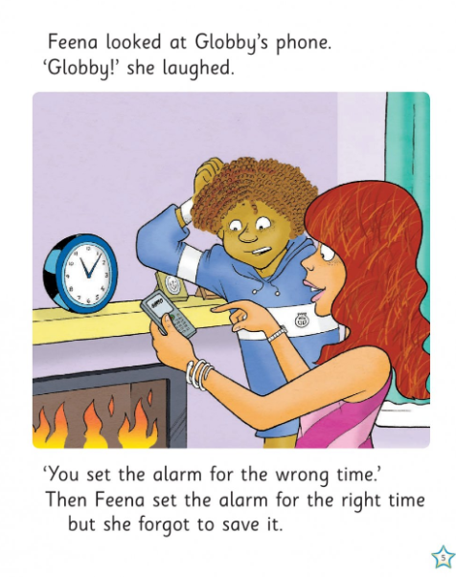
What time is on the clock? Is that early or late?
How does Globby look?

Slide 6
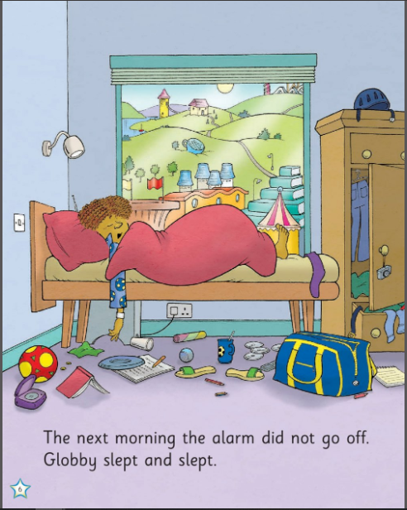
Is the room clean?
Name 5 things you can see in the room.
Name 5 things you can see in the background
What clothes can you see?
What you think might the bag on the floor be used for?
Is Globby awake or asleep?

Slide 7
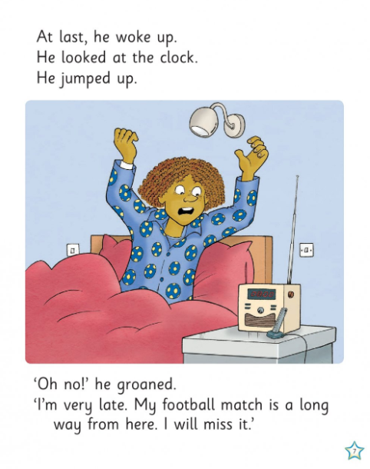
How does Globby look
What is on the locker?
How did he know what time it was?
What are the switches on the wall for?

Slide 8
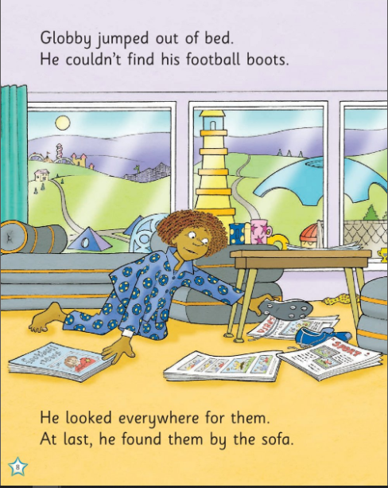
What is the weather like?
What is on his PJ’s?
What is in his hand?
How many papers are on the ground?

Slide 9
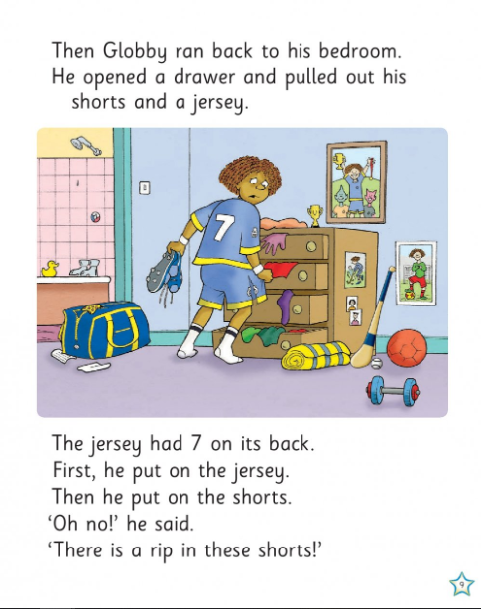
How many drawers are there?
Who is in the pictures on the wall? What is he doing?
What other room can you see on the left?
What number does Globby have on his jersey?
Name the sports equipment that you can see?

Slide 10
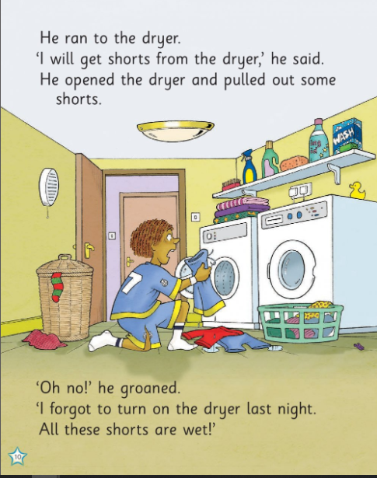
What room is he in now?
What is in the basket do you think?
What are the two machines called?
Why cant he wear his shorts?
How many light switches are there?
How many plugs can you see?
What are all the products on the shelf?

Slide 11
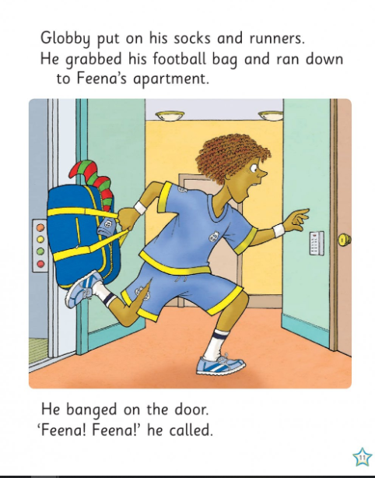
What is wrong with Globby’s shorts?
What kind of expression is on Globby’s face?

Slide 12
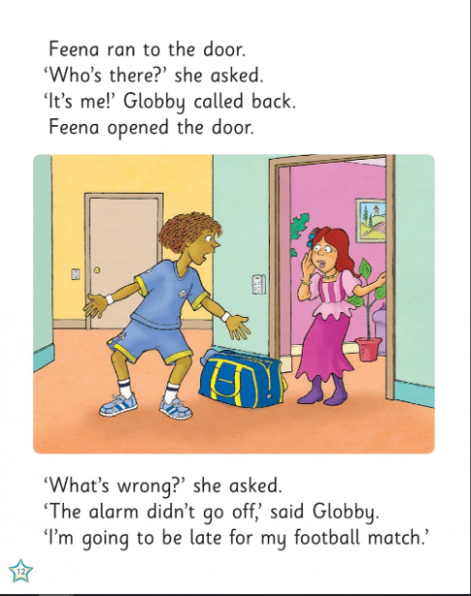
Why is Globby panicking?
Name the things you can see in Feena’s apartment?
Does she look happy?

Slide 13
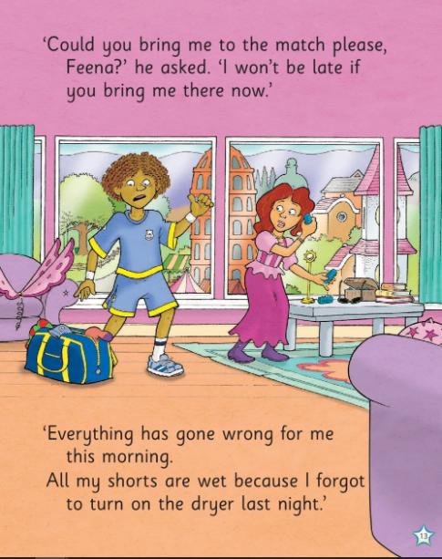
What is on Feena’s couch?
How many buildings can you see out the window?
Name 5 things you can see in the apartment
Is it tidy or messy?

Slide 14
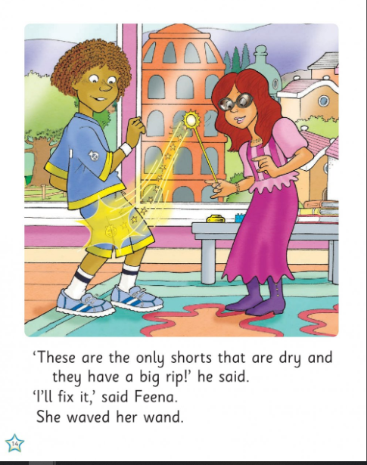
What is Feena doing with her wand?
How many stars can you see?
Do they look happy or sad?

Slide 15
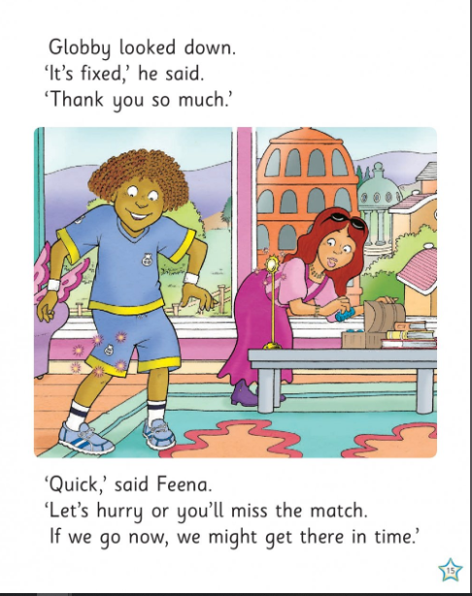
1. Name a time when someone helped you and you felt happy.

Slide 16
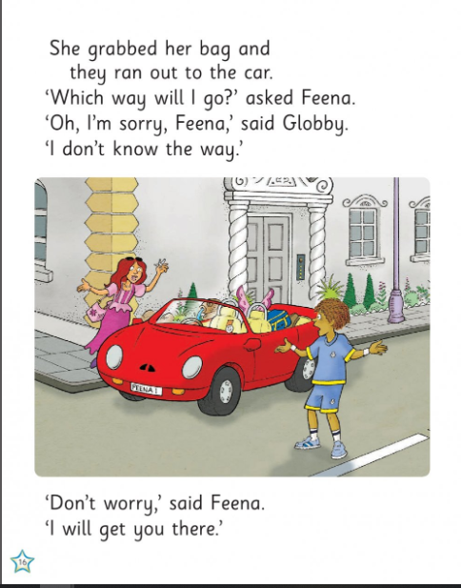
Why do they look confused?
What things are in Feena’s car?
What kind of car has no roof?
How many windows can you see?

Slide 17
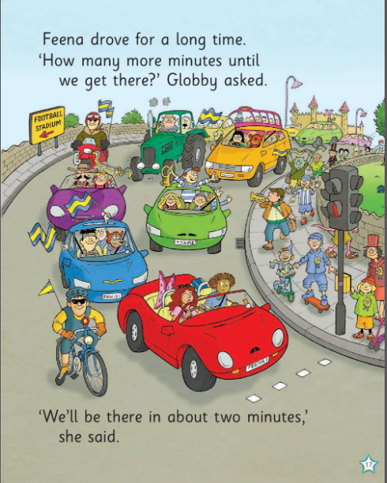
How many cars can you see?
What other vehicles can you see?
Would a car or bike be faster?
What does the yellow sign say?
They all seem to be going to the football match. How do we know?
What are the team colours?

Slide 18
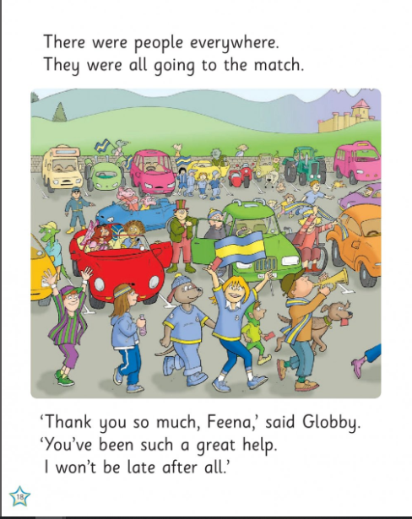
Do the people look sad? How would you describe them?
Name 5 colours you can see.

Slide 19
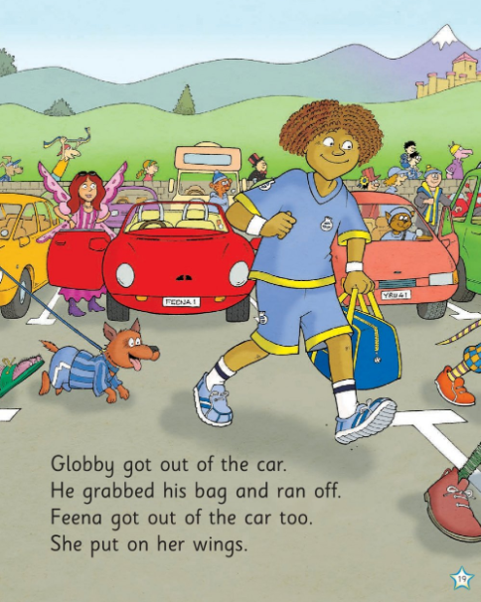
Count the people in the picture
What does Feena’s number plate say?
How does Globby look now?

Slide 20
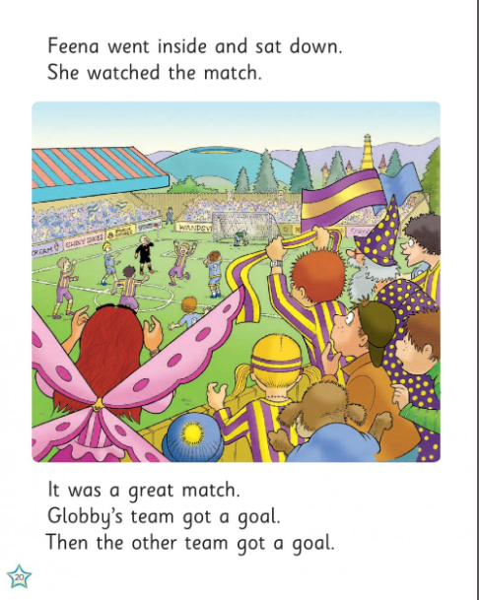
What colours are the other team?
Is the stadium empty or packed?
Who are you supporting?

Slide 21
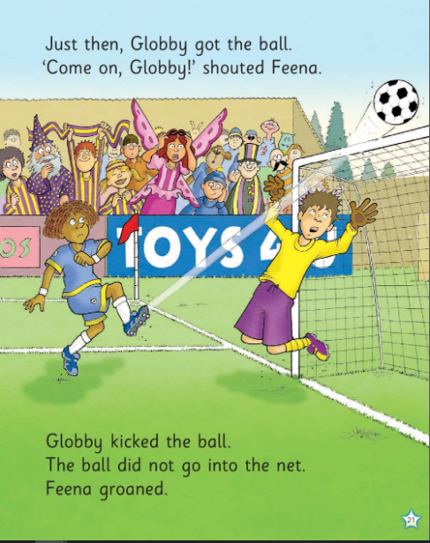
Describe Feena’s face
What is goalie doing?
Count how many people are dressed in yellow and purple

Slide 22
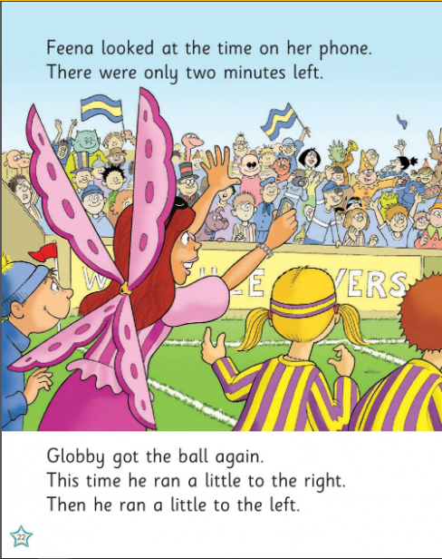
How does Feena look?
Which team is she cheering for? Why do you think that?

Slide 23
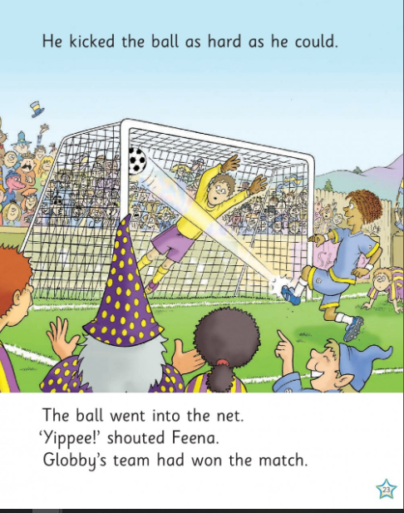
How many black patches can you see on the ball?
Do you think the supporters are happy with Globby?
Is the goalie happy?

Slide 24
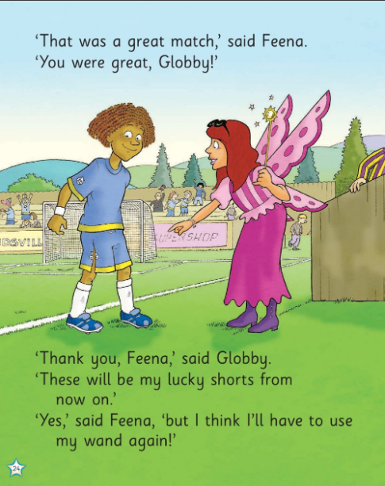

Slide 25
